Slide 1
4 step sketch

Slide 2
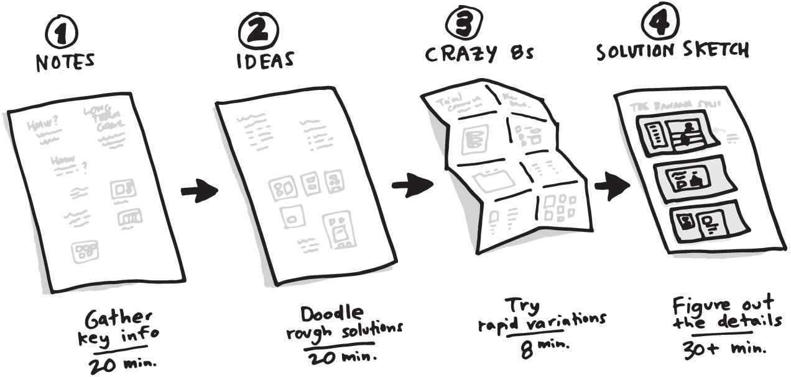
The Four-step Sketch

Slide 3
Notes
You and your team will walk around the room, look at the whiteboards, and take notes
Write down anything that looks useful.
At the end of notes time, the team closes their laptops and phones. Take another three minutes to review what you wrote down. Circle the notes that stand out. They’ll help you in the next step.

Slide 4
Ideas
Each person will jot down rough ideas, filling a sheet of paper with doodles, sample headlines, diagrams, stick figures doing stuff—anything that gives form to his or her thoughts
It doesn’t matter if these ideas are messy or incomplete. Take twenty minutes for idea generation. When you’re finished, spend an extra three minutes to review and circle your favorite ideas.

Slide 5
Crazy 8s
Crazy 8s is a fast-paced exercise. Each person takes his or her strongest ideas and rapidly sketches eight variations in eight minutes. Crazy 8s forces you to push past your first reasonable solutions and make them better, or at least consider alternatives.
And before you get the wrong idea, the “crazy” in Crazy 8s refers to the pace, not the nature of the ideas. Forget about the traditional brainstorm advice to be goofy. We want you to focus on good ideas—the ones you believe will work and help you hit your goals—and use Crazy 8s to tweak and expand on those good ideas.

Slide 6
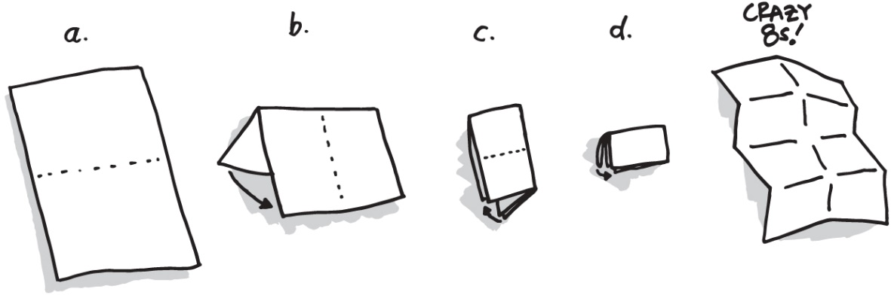
Crazy 8s
Each person begins Crazy 8s with a single sheet of letter-size paper. Fold the paper in half three times, so you have eight panels. Set a timer to sixty seconds. Hit “start” and begin sketching—you have sixty seconds per section, for a total of eight minutes to create eight miniature sketches. Go fast and be messy: As with the notes and ideas, Crazy 8s will not be shared with the team.

Slide 7
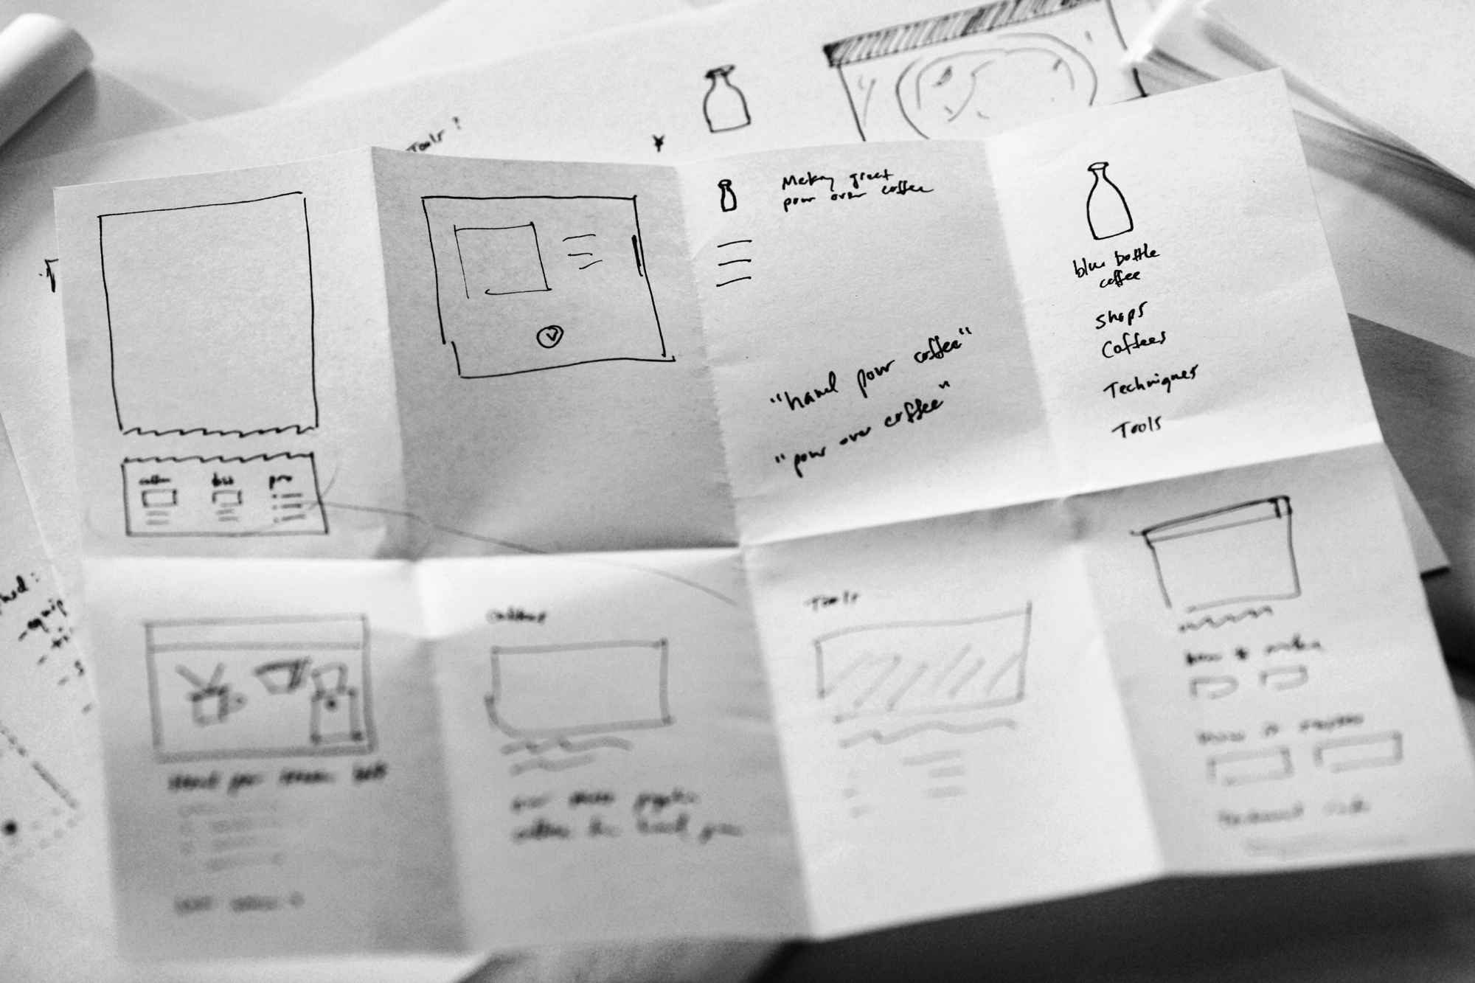
Crazy 8s
The exercise works best when you sketch several variations of the same idea
If your idea contains words or marketing headlines or any other bits of text, you can use Crazy 8s to improve your phrasing

Slide 8
Solution Sketch
Make it self-explanatory
Keep it anonymous
Ugly is okay
Words matter
Give it a catchy title

Slide 9
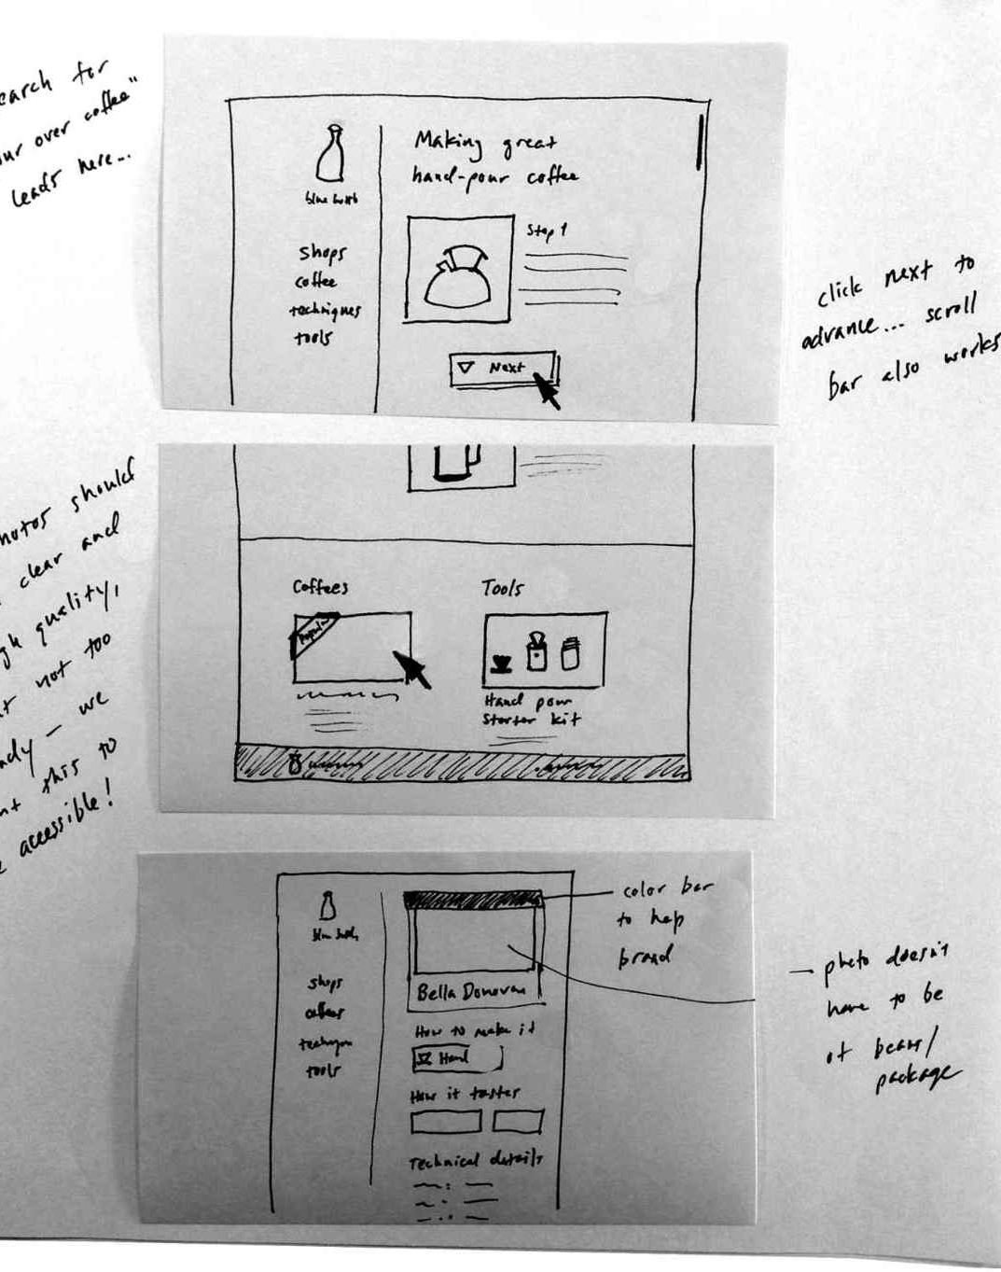
Solution Sketch Example

Slide 10
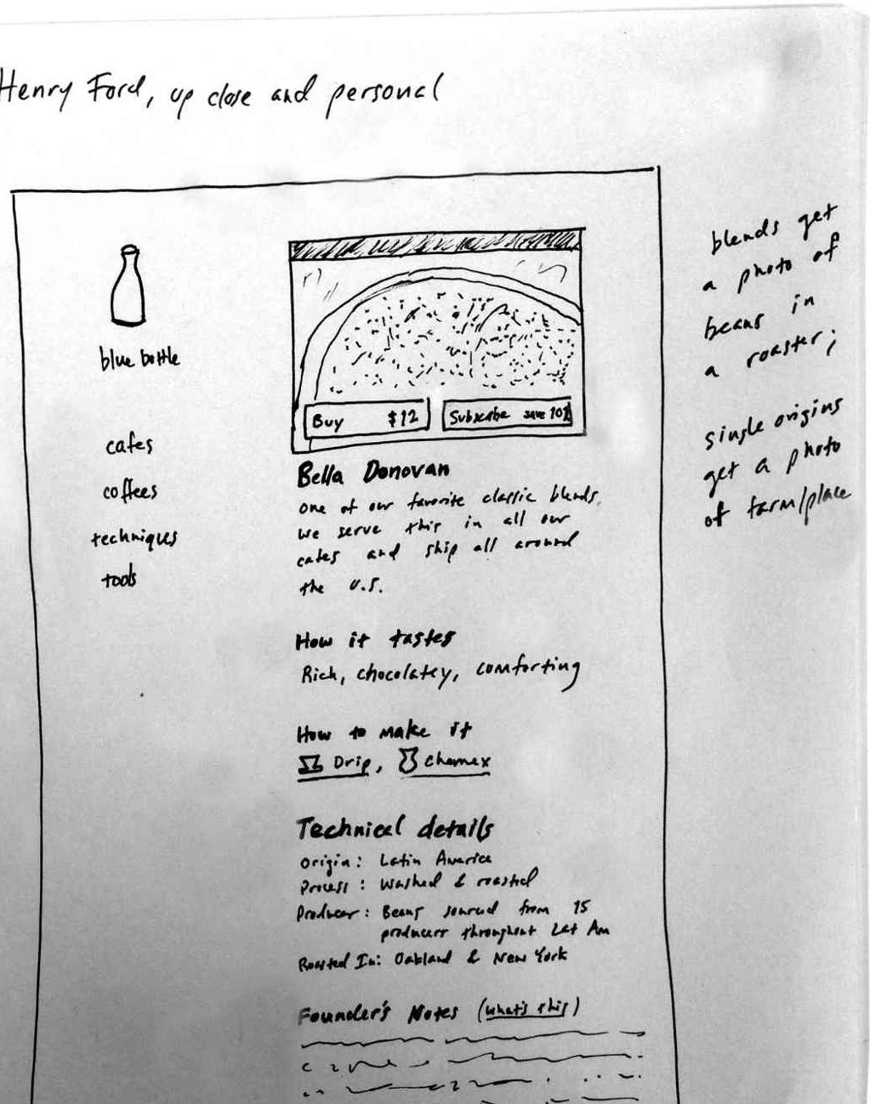
Solution Sketch Example

Slide 11
Tugas
Buatlah 4 step sketch dari ide usaha anda, dapat Digambar secara sederhana di kertas a4 atau menggunakan word atau canva

